Slide 1




WELCOME
“Thailand 201: Supply Chain and Raw Materials”
September 21st, 2023

Slide 2
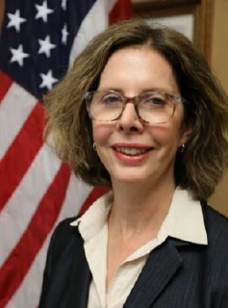

OPENING REMARKS:
THAILAND’S MAJOR NON-NATO ALLY STATUS
Catherine Spillman
Senior Commercial Officer
US Embassy Bangkok Office of Foreign Commercial Services

Slide 3


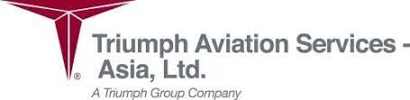
THAILAND’S LOGISTICS AND SUPPLY CHAIN ADVANTAGES
Barry Crawford
Aerospace Committee Co-Chair,
American Chamber of Commerce (AMCHAM) Thailand
& Supply Chain Director at Triumph Aviation Services, Asia

Slide 4
SUPPLY CHAIN INSIGHTS
Strengths (and Weaknesses) of Thailand's Aerospace Supply Chain infrastructure
Thailand’s Logistics advantages
Key Supply Chain Challenges in 2023
Impacts and Strategies to Mitigate Challenges
Benefits of EEC/BOI and Free Zone in Thailand

Slide 5
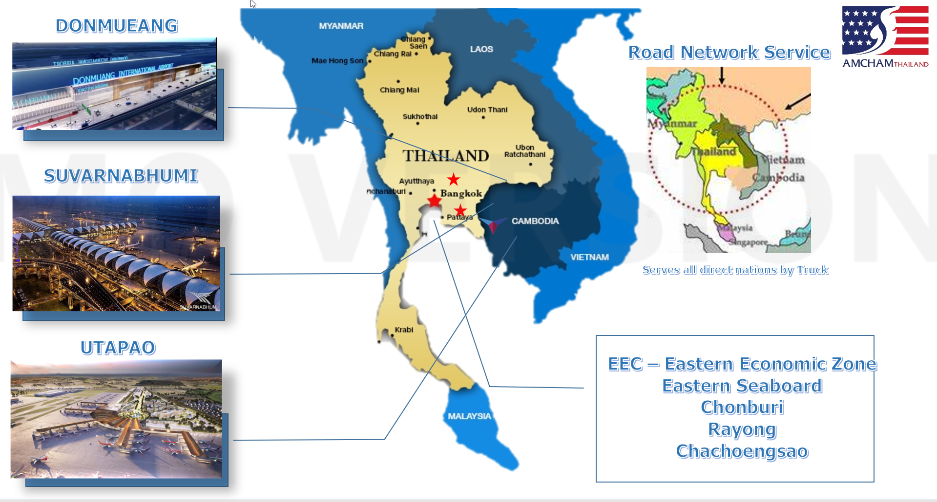
WHAT AND WHERE?

Slide 6
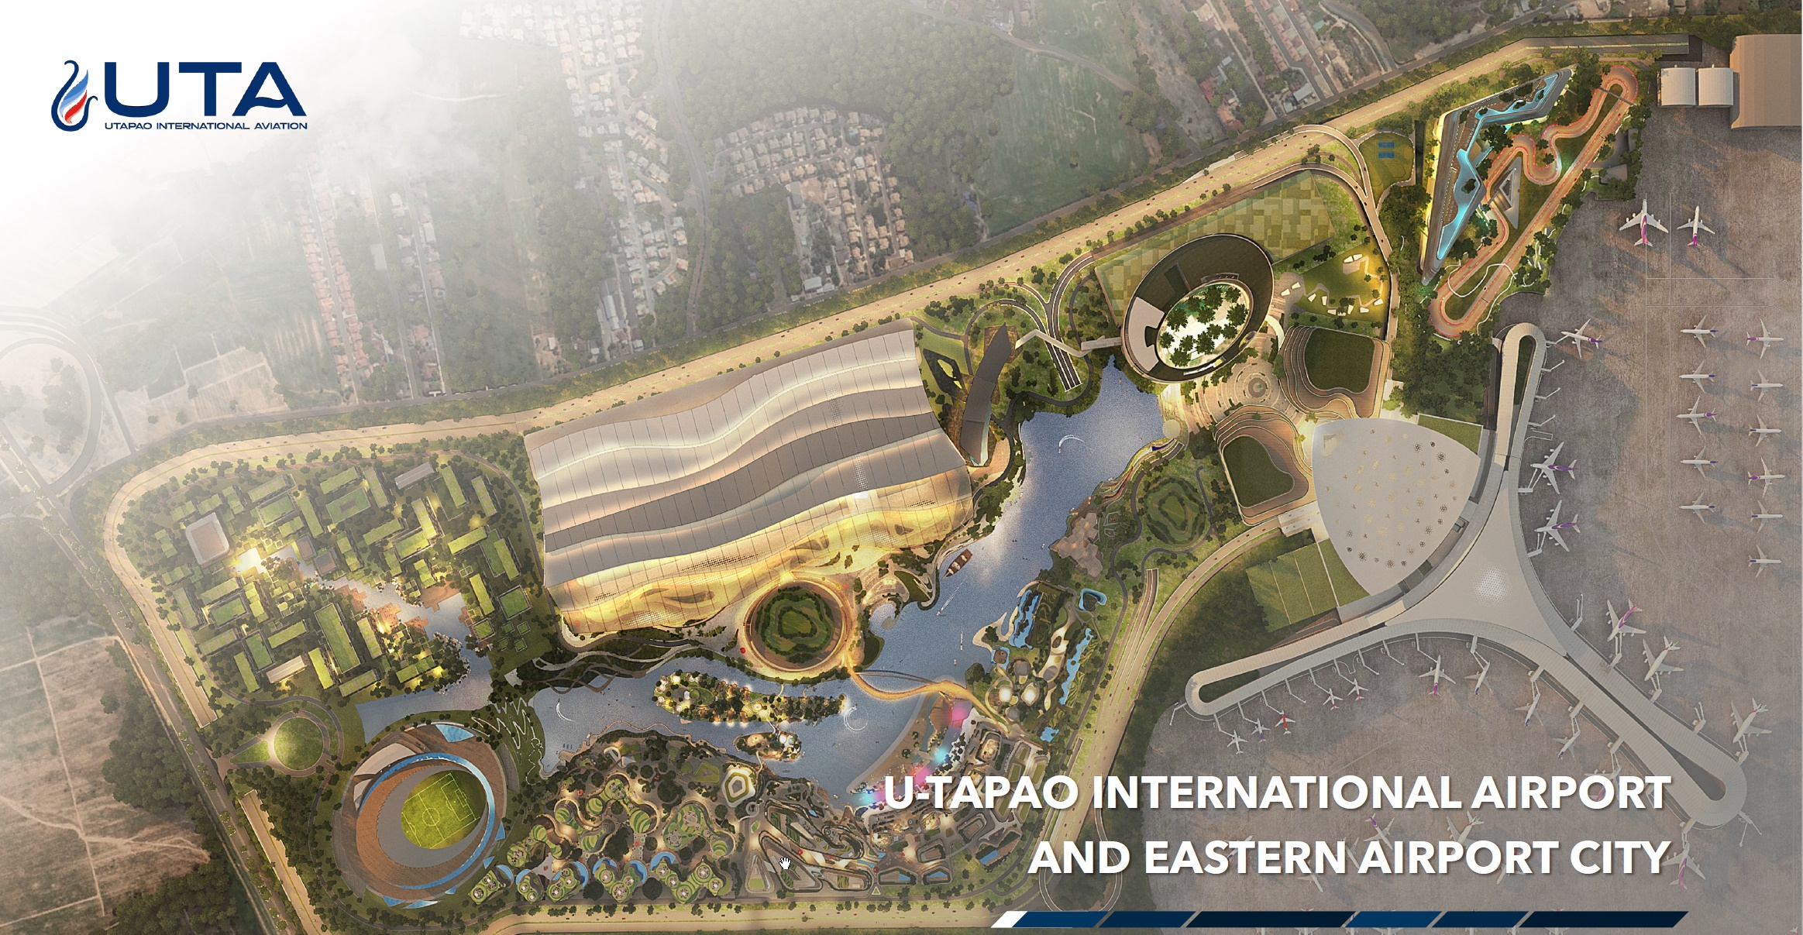
EEC / U-TAPAO AIRPORT / AIRPORT CITY - AEROTROPOLIS

Slide 7
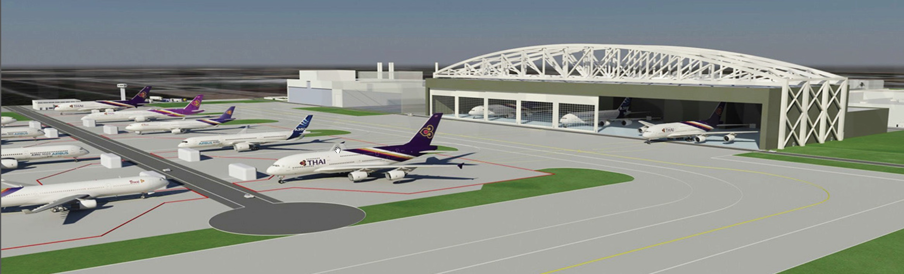
PROPOSED MRO – REGIONAL REACH – NARROWBODY FOCUS

Slide 8
2023 ASSESSMENT: THAILAND SUPPLY CHAIN SNAPSHOT
CHALLENGE
STRENGTH
SKILLED WORKFORCE
(FOR TECHNICAL WORKERS)
THAILAND’S INFRASTRUCTURE
CHALLENGE
IMPROVING
STRENGTH
RAW MATERIAL PROCUREMENT
MITIGATED BY DESIGN: BOEING / AIRBUS
REGULATORY COMPLIANCE
CAAT, EASA, FAA, CAACC, & CAAS
LOGISTICS AND LOCATION

Slide 9
IMPACTS AND STRATEGIES TO MITIGATE SUPPLY CHAIN CHALLENGES
Supplier Management / Collaboration / Diversification – Networking – Negotiation and Information Exchange
Material Management / Strategic Sourcing / Recycling and Waste Reduction
Demand Forecasting and Planning – Operational Efficiencies – Data Analysis
Cost Control by Technology Adoption, Continuous Improvement and LEAN/OE measures
Challenge: Chemicals and Special Processes (Surface Treatments, Heat Treatment, Shot Peening, NDT – other Nadcap certificated processes).

Slide 10


OVERVIEW: ESTABLISHING A BUSINESS IN THAILAND
Charles Blocker
CEO
IC Partners Limited

Slide 11
ESTABLISHING A BUSINESS IN THAILAND:
DE-RISKING INVESTMENT | TAKING ADVANTAGE PROGRAMS & PLATFORMS
US-Thai Treaty of Amity
  https://th.usembassy.gov/wp-content/uploads/sites/90/Treaty-of-Amity-and-Commerce-between-Siam-and-the-United-States-1833.pdf
  https://en.wikipedia.org/wiki/Treaty_of_Amity_and_Economic_Relations_(Thailand%E2%80%93United_States)
Thailand Board of Investment (BOI)
  https://www.boi.go.th/en/index/
Leveraging Existing Core Competencies/Investment of EEC & Thailand
  STEM Workers
  Existing Supply Chain & Raw Materials
  Transportation Infrastructure

Slide 12
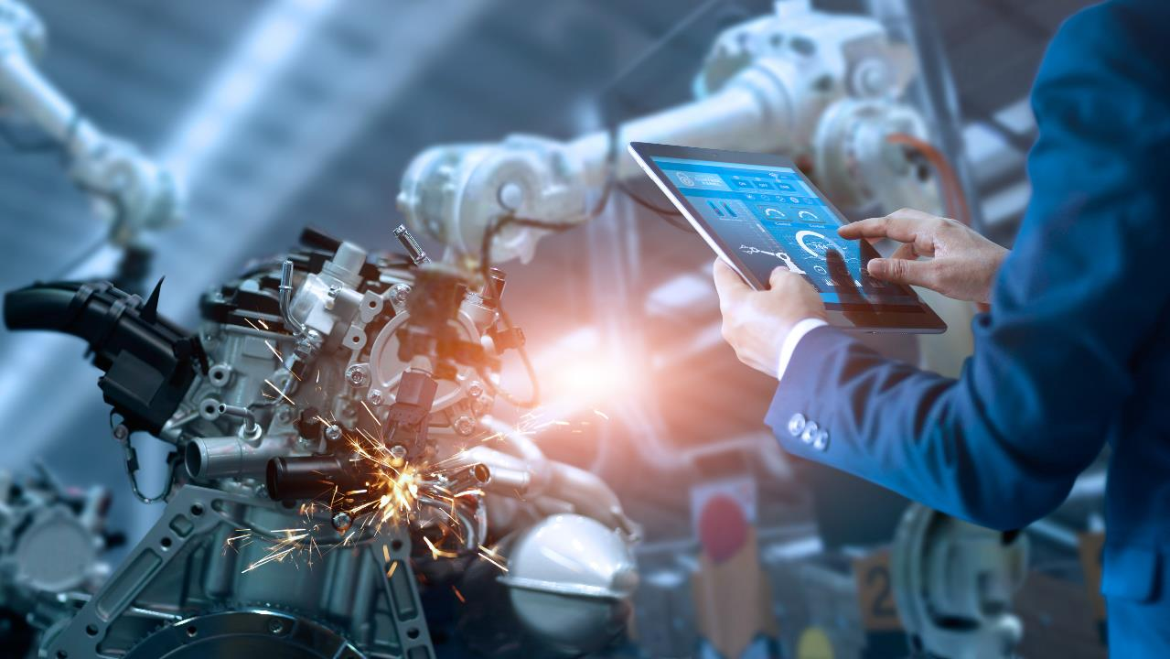







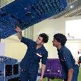

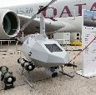
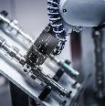

12
TARGETED INDUSTRIES
PROMOTING ADVANCED TECHNOLOGY AND INNOVATION
DECARBONIZATION
HEALTH & WELLBEING
NEXT-GENERATION
AUTOMOTIVE
ADVANCED AGRICULTURE
AND BIOTECHNOLOGY
FOOD FOR
THE FUTURE
MEDICAL AND COMPREHENSIVE
HEALTHCARE
HIGH-VALUE AND
MEDICAL TOURISM
BIOFUEL AND
BIOCHEMICAL
LOGISTICS
HUMAN RESOURCES
DIGITAL
AEROSPACE &
LOGISTICS
EDUCATION AND HUMAN RESOURCE DEVELOPMENT
DIGITAL
DEFENSE
AUTOMATION
AND ROBOTICS
INTELLIGENT
ELECTRONICS

Slide 13









THE EEC AND DEFENSE INDUSTRY:
ALIGNED WITH THAILAND’S TECHNOLOGY GOALS
Defense Technology Products
Dual use
technologies
EEC Targeted Industries
Defense Applications
Satellite
Unmanned Vehicles/AV
UAV (Drone)
Automation/ AI
Aviation and Logistics
Defense
Technologies
Intelligent Electronics
EV
Automation & Robotics
Industrial robot
3D printing solution
Sensor and Laser
Next-generation Automotive
Disaster Management
Digital
Cybersecurity
C1-1

Slide 14
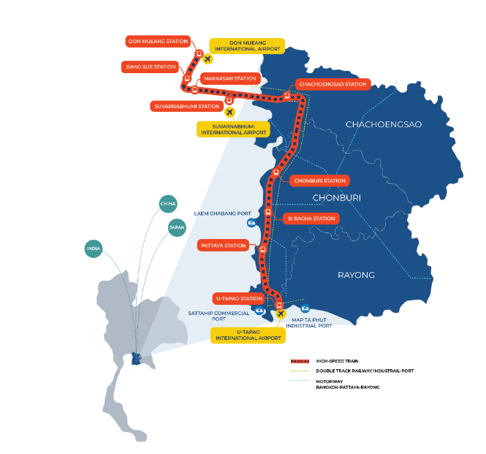

EEC AND DEFENSE INDUSTRY:
MANY AREAS AROUND THAILAND SUPPORT DEFENSE
  Arms and Defense Industry
  Specific areas for development and armament testing
  Dual Use Technology in the EEC
  Crucial Technology-focused Infrastructure for Development
  EECi : Aripolis
  Science, Technology, and Innovation (STI)
  Robotics, Automation, UAV and Data Analytics
  EECd : Cyber Security and Digital
  Space Innopolis
  Research and Earth Observation Satellite
  U-Tapao Airport
  Aircraft Maintenance, Repair, and Overhaul (MRO)
  Sattahip Port
  Shipbuilding (OPV/ Coastal Trading Vessels)

Slide 15












BOARD OF INVESTMENT:
SUPPORT TO GROWING THAILAND’S DEFENSE INDUSTRY
What is the Board of Investment (BOI)?
BOI is a Thai government agency that promotes inbound investment to Thailand by providing tax and non-tax incentives to eligible projects
Tax Incentives
Non-Tax Incentives
  Corporate income tax exemption period
  50% reduction of corporate income tax
  after the expiry of tax exemption period
  Exemption of import duties on machinery
  Exemption of import duties on raw materials used to manufacture exports and for R&D purposes
  100% foreign ownership
  Land ownership rights
  Work permit & visa facilitation
  (for top management and experts)
  No restriction on foreign currency
What Tools Does BOI Offer?
One Start One Stop
Investment Center
Staff from numerous investment-related agencies in one place
Visas and work permits <3 hours
Privileges for
SMART Visa
4-year visa with permission to work without work permits
No re-entry required & fast track service at international airports
Support to
Industrial Linking
Help sourcing Thai subcontractors & parts
Business matching services

Slide 16
Investment Incentives for the defense industry (1/3)
List of activities eligible for BOI’s promotion
Activities | Incentives | Criteria | Additional incentives, located in the EEC
4.20 Manufacture and/or repair of vehicles and weapon systems for national defense i.e. tanks, armored tanks, combat-facilitating vehicles | Package A2 8-year Corporate income tax exemption Exemption of import duties on machinery and raw materials Non-tax incentives | Must be manufacturing and/or repair according to the requirements of a national security agency Must meet the industrial or military standards specified by the Ministry of Defense In case of repair, it must be major repair and/or repair using advanced technology | YES Additional 3 years of 50% corporate income tax reduction (in case of human resource development) Additional 2 years of 50% corporate income tax reduction (in case of projects located in a specific area i.e. EECa)
4.21 Manufacture and/or repair of unmanned systems for national defense and parts thereof i.e. unmanned ground systems, unmanned maritime systems, unmanned aircraft systems) | Package A1 8-year Corporate income tax exemption (no ceiling) Exemption of import duties on machinery and raw materials Non-tax incentives
  * For Human Resource Development Criteria
  Must establish a cooperation with institutions or organizations to develop human resources in Science & Technology
  The training participants must not be less than 10% of the total number of employees or more than or equal to 40 participants.

Slide 17
Investment Incentives for the defense industry (2/3)
List of activities eligible for BOI’s promotion
Activities | Incentives | Criteria | Additional incentives, located in the EEC
4.22.1 Manufacture and/or repair of weapons, and parts thereof i.e. bullets, firearms, rocket systems | Package A2 8-year Corporate income tax exemption Exemption of import duties on machinery and raw materials Non-tax incentives | Must be manufacturing and/or repair according to the requirements of a national security agency Must meet the industrial or military standards specified by the Ministry of Defense In case of repair, it must be major repair and/or repair using advanced technology 4.22.1 the promoted project must have Thai shareholders of no less than 51% of the registered capital (in accordance with the Private Weapon Manufacturing Factory Act B.E. 2550 (A.D. 2007) 4.22.2 must have its own system design or software development | YES Additional 3 years of 50% corporate income tax reduction (in case of human resource development) Additional 2 years of 50% corporate income tax reduction (in case of projects located in a specific area i.e. EECa)
4.22.2 Simulation and virtual training systems such as virtual training facilitating systems for combat vehicles, personal weapon and unit weapon training field systems, Joint Theater Level Simulation systems (JTLS), etc. | Package A1 8-year Corporate income tax exemption (no ceiling) Exemption of import duties on machinery and raw materials Non-tax incentives
  * For Human Resource Development Criteria
  Must establish a cooperation with institutions or organizations to develop human resources in Science & Technology
  The training participants must not be less than 10% of the total number of employees or more than or equal to 40 participants.

Slide 18






Investment Incentives for the defense industry (3/3)
List of activities eligible for BOI’s promotion
Activities | Incentives | Criteria | Additional incentives, located in the EEC
4.23 Manufacture and/or repair of combat facilitating equipment such as bulletproof and flak-proof vests, bullet-proof and flak-proof shields | Package A2 8-year Corporate income tax exemption Exemption of import duties on machinery and raw materials Non-tax incentives | Must be manufacturing and/or repair according to the requirements of a national security agency Must meet the industrial or military standards specified by the Ministry of Defense In case of repair, it must be major repair and/or repair using advanced technology | YES Additional 3 years of 50% corporate income tax reduction (in case of human resource development) Additional 2 years of 50% corporate income tax reduction (in case of projects located in a specific area i.e. EECa)
What is BOI’s Criteria for project approval?
≥ 1 million baht
(excluding cost of land
and working capital)
debt-to-equity
≤ 3 : 1
value-added
≥ 20%
environmental
protection
New machinery & modern
production processes
ISO certification
Projects with
≥10M THB
investment

Slide 19
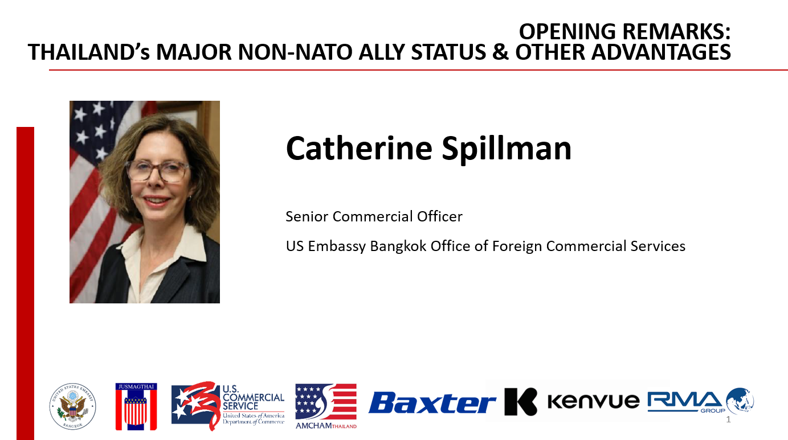

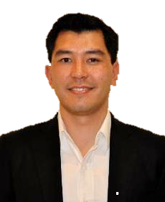

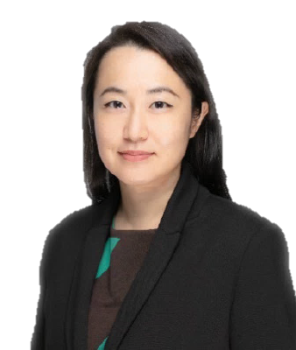


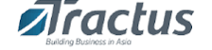
ROUND TABLE DISCUSSION & CASE STUDIES:
SUPPLY CHAIN IN THAILAND’S EASTERN ECONOMIC CORRIDOR (EEC)
Billy Auer
Director, Fulfillment Asia Pacific
Baxter Healthcare
Veeraya Kaewwilai
Senior Director, Operations
Kenvue Thailand
Seb Robertson
General Manager Global Sales
RMA Automotive
Frank Timmons
MODERATOR
Senior Manager
Tractus Asia

Slide 20

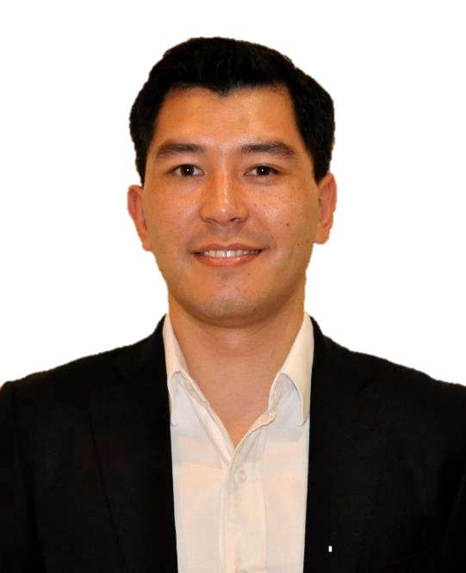
Billy Auer
Director, Fulfillment Asia Pacific
Baxter Healthcare

Slide 21
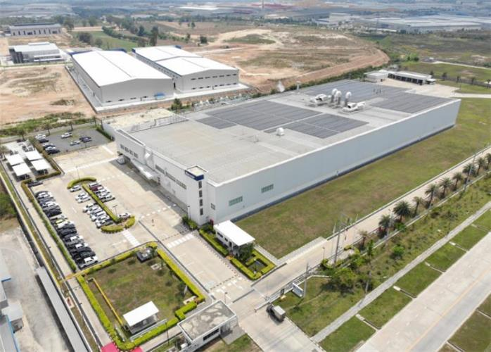
BAXTER THAILAND
Trading Company
Location Bangkok
Operations Import and sale of medical device and pharmaceutical products
Manufacturing
Location: Amata City Rayong Industrial Estate, Rayong
Main Technology: WFI Production, Plastic Extrusions, Sterilization, Assembly line for Solutions

Slide 22
SOME CONSIDERATIONS FOR OPERATING
IN THE INDO PACIFIC
Where are your customers?
Market access
Logistics infrastructure and port access
What technical capabilities are needed?
Engineering and technical personnel capabilities
Third party suppliers for raw materials and services
Anything else? Tax, trade agreements, etc…

Slide 23

Veeraya Kaewwilai
Senior Director, Operations
Kenvue Thailand

Slide 24


Slide 25

Our purpose
At Kenvue, we realize the extraordinary power of everyday care.
$15bn
2022 Net Sales
3
Segments
135+
Year History
~1.2bn
People Served
across
>165
Markets
50+
Markets with Direct
Distribution
25
Notes:
At Kenvue, we believe in the extraordinary power of everyday care
We are the world’s largest pure-play consumer health company by revenue.
Formerly known as Johnson & Johnson Consumer Health,
we became a fully independent company from Johnson & Johnson in August 2023
when we also joined the S&P 500 on the New York Stock Exchange.
From Tylenol to Band-Aid, to Listerine to name a few—
our iconic brands have played a role in everyday care routines
for over 135 years
and, today, reach households in over 165 countries.

Slide 26
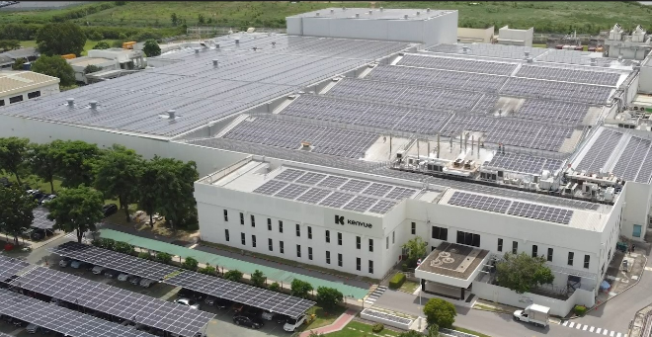


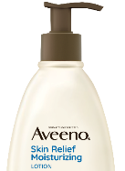

Our Supply Chain Operations in Thailand
Produces brands such as
Listerine®, Aveeno®, OGX® Neutrogena®, Carefree, Stayfree, Modess and Johnson’s Baby®
50+
38+
Years in Thailand
Markets across Asia Pacific,
North America, EMEA
2022
2023
World Economic Forum Lighthouse Designation
GOLD level of TRUE Certification for Zero Waste
Industry Town Award & Eco Factory Award
(Industrial Estate Authority of Thailand)
Outstanding Cosmetics
Manufacturing (FDA)
Alliance for Water Stewardship Certification
4th Level Green Industry Award (Ministry of Industry)
Notes:
We have been in Thailand for more than 50 years
and our manufacturing site here is a strategic regional supply hub for the Company.
We manufacture products such as Listerine, Johnson’s Baby, Aveeno, and Neutrogena -- exporting to over 38+ markets around the world
across Asia-Pacific, EMEA, and North America.
Our Thailand Plant was recognized with a Lighthouse Designation by the World Economic Forum in 2022 for leveraging Fourth Industrial Revolution technologies
We have also been credited for our efforts
in driving Sustainable Operations that’s better for our planet –
From Alliance for Water Stewardship" certification to Eco Factory award last year
To GOLD level of TRUE certification for Zero Waste
and the 4th Level Green Industry Award from the Ministry of Industry.

Slide 27
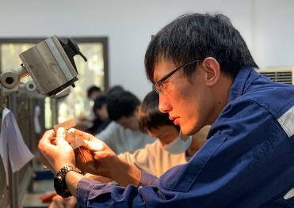

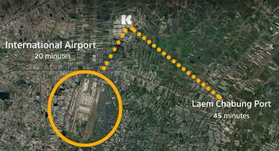





Thailand as a Strategic Supply Chain Hub
Advancements in Technology
Well-developed transport infrastructure, significant cross-border trade, & supportive governmental policies
Competitive Labor Market
Business Growth
Inventory Reduction
End-to-End Supply Chain Lead Time Reduction
Productivity Improvement
Carbon Footprint Optimization
Notes:
What these credits illustrate further to us is that
Thailand has proven to be a favorable environment for our manufacturing plant
to serve as a strategic hub for the Company over the years,
and I’d like to touch on a few major enablers behind this.
First, Technology is absolutely changing the game,
and we see that this is crucial for a resilient supply chain.
Thailand’s economic model supports the advancement of digital infrastructure
and creates opportunities
for increased automation and digitalization within supply chains.¹
This market has been conducive to our focus at Kenvue in building an end-to-end, digitally connected supply chain ecosystem.
For example, in order to meet evolving market dynamics, Kenvue enacted ‘Smart Operations,’ which utilizes intelligent automation, predictive maintenance and digital quality to optimize sourcing, manufacturing and demand planning capabilities, capture product deviations, provide better insights, and anticipate issues —all in real time—therefore eliminating “flow breakers” or “reliability defects” across our Supply Chain.
Our Thailand Plant has been a leading site for us
to pilot some of these technological and digital advancements for Kenvue globally.
Second, Thailand is home to a competitive labor market.
With a focus on knowledge workers
with high literacy levels in many languages
and highly skilled labor in the engineering and operations space.
We are able to attract strong and diverse talent
to build resilience supply chain and unlock the full potential of our operations.
These two key factors are combined with a location that has well-developed transport infrastructure
With great access to both the International Airport and Sea Port.
this also means we have access to global key suppliers of raw and packaging material based in close proximity
something that’s hugely beneficial as it brings the opportunity for increased collaboration,
innovation, and an optimization of lead times along our value chain
Thanks to these enablers, our Thailand plant can become a strategic hub for the company

Slide 28
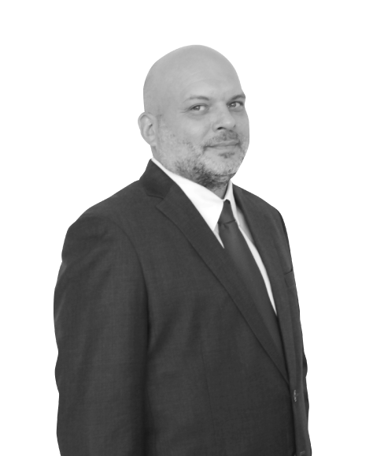
Seb Robertson
General Manager Global Sales
RMA Automotive

Slide 29
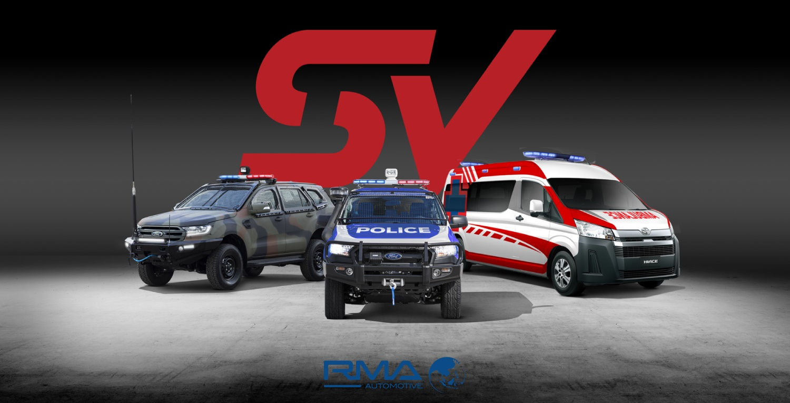
Notes:
Please play this intro:
ttps://www.youtube.com/channel/UC4VEA98O_u8WgOKVUv6eoFw

Slide 30
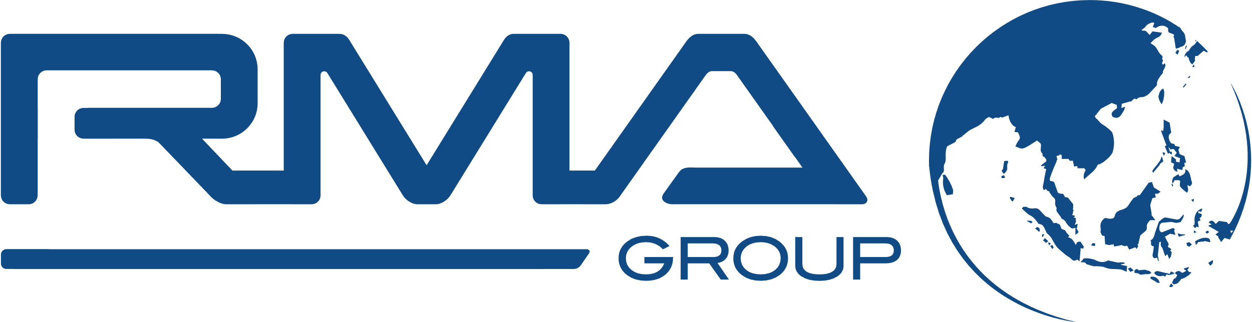
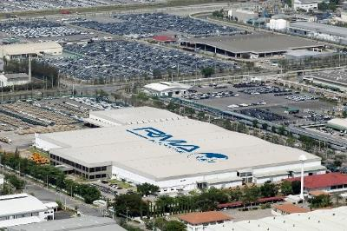
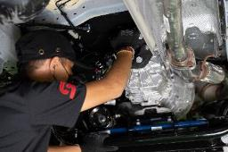
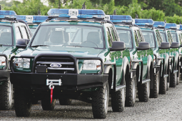
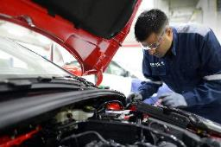
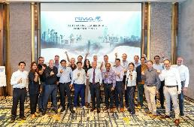
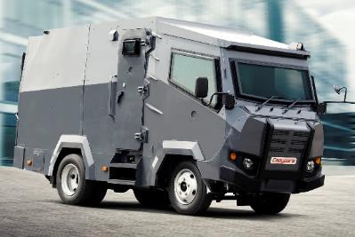
Our Competitive Edge
Financial strength
>$ 1 Billion
Annual turnover with
strong underlying profitability
Engineering
Excellence
8 Vehicle modification centers
Exceptional track record
>300,000 Vehicles
Delivered globally
35+ years
Expertise and Extensive Experience
Operational reach
>8,000 employees
Located in 14 countries
Customized
Products &
Services

Slide 31





RMA Group Operations
INFRASTRUCTURE
Heavy Equipment Agriculture Equipment
Power Equipment
Warehousing & Distribution
Special Products
FINANCIAL SERVICES
Leasing
Hire Purchase
Installment Sale
Vehicle Rental
ENGINEERING SOLUTIONS
Mechanical & Electrical Contracting
Design, Installation, Maintenance & Service
Solar & Renewables
Distribution
HOSPITALITY
Food & Beverage Franchises
Airport F & B
FCC Hotel Management
AUTOMOTIVE
Modifications Design, Assembly & Manufacturing
Fleet Sales & Solutions
After Sales, Service, Parts Sales & Training
Retail & Wholesale Operations

Slide 32
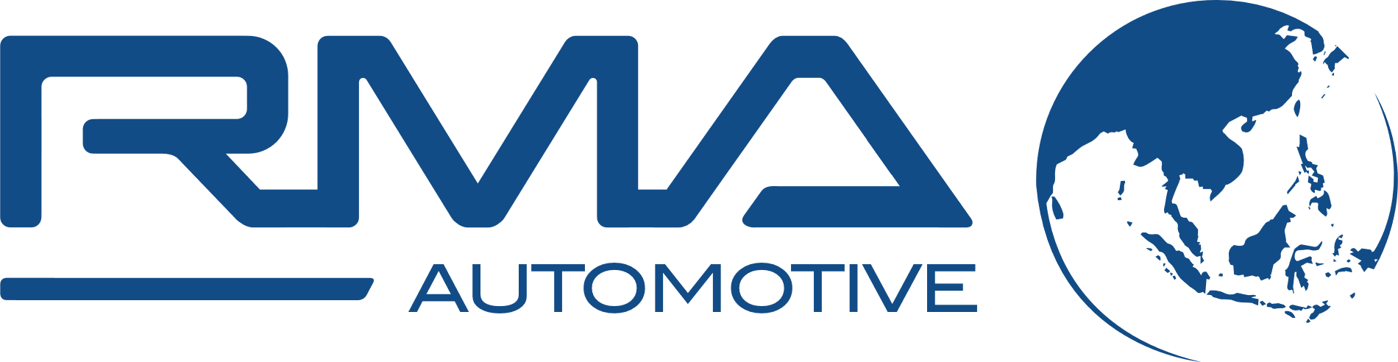
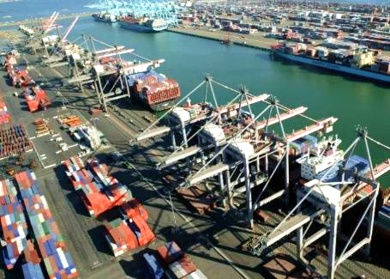
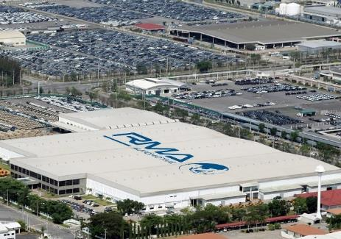
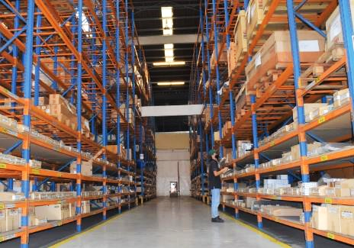
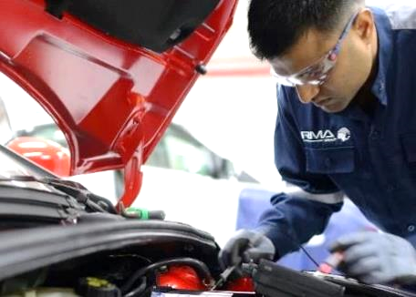
Thailand Supply Chain for RMA
Logistics
Located in Freezone
Warehouse Management
Modifications Technical Support
Freight forwarding (road, rail, sea and air). Superior know-how to handle large volume shipments.
Well-versed with all the procedures and regulations to avoid the complexities of customs processes and long delays.
90,000m² fully secured Thailand facility with capacity of up to 3,000 vehicles.
Located at Laem Chabang Port Free Zone, Thailand.
5 Kms distances to Laem Chabang Port (Ro-Ro, Container Terminals).
Customs and Free Trade Agreement Specialist In-House.
Cooperate MOD, NBTC, FDA, Excise and DIW Departments of import/ Export License experiences.
10,000${\text{m}}^{2 }$ warehouse space.
26,000 binning locations and 19,000 parts lines.
Tailor-made parts shipment consolidation and packing requirements.
Scheduled parts inventory and warehouse competency training.
24/7 online technical support through RMA’s dedicated website.
Field Engineers available for deployment across the globe.
Accessories Supply and Installations.
Expertise in Repair, Decorate, Modifications and Conversions.

Slide 33

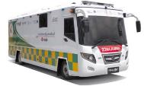
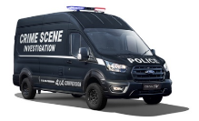

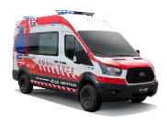


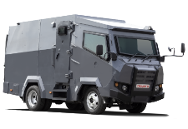
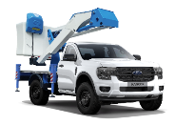


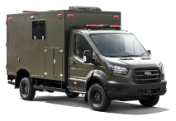

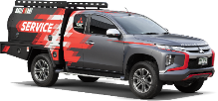
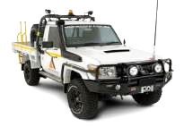

Examples of RMA Modification Projects
Emergency
Security
Industrial
Defense
Notes:
Ambulance box
Medical / HVAC
Suspension
Lighting
…
Bumpers, roll bar
Side steps, roof rack
Suspension upgrade, wheels and tires
Painting
…

Slide 34



Categorization of the Main Purchasing Commodities
Purchasing Segmentation (main commodities)
Thailand
Professional buyers
Recognized industries (automotive, aviation, etc)
Existing pool of suppliers
International standards, laboratories
Metal Systems
Electrical Systems
Composite Systems
Metal fabrication, Bumpers, Racks, Bodyworks
Drivetrain,
Steering, Suspension,
Wheels & tires
Wiring harness,
Electrical Components
Lighting
Cameras, Communication
Medical Equipment
Upholstery, Trimming, Seat covers, Floor mats
Plastic injection and components
Boxes, Canopies,
Paint

Slide 35
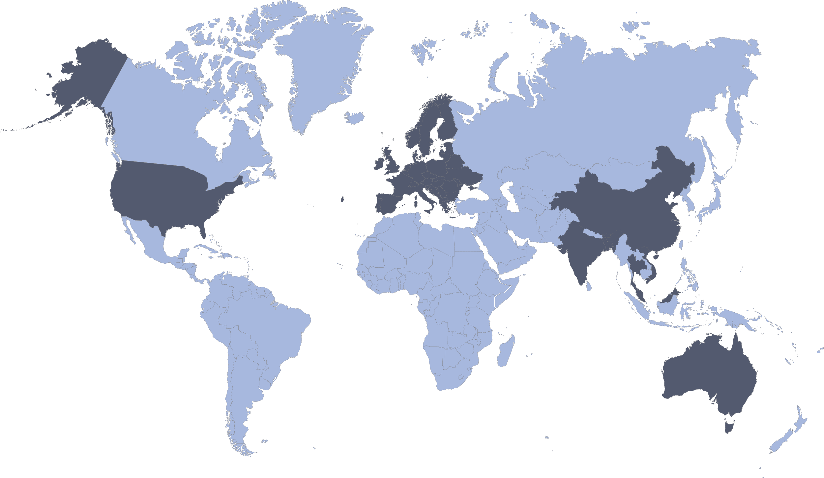
Localization of the Main Purchasing Commodities
SOURCING REGIONS
Thailand - Eastern Economic Corridor
Dynamic Region / various sources of supply / easy communication and transportation
Free-Trade Economic Zone
FTA in place (examples)
ASEAN Free Trade Area (AFTA)
ASEAN-China
ASEAN-South Korea
Thailand-Australia
Thailand-Japan
Thailand-India
The Regional Comprehensive Economic Partnership (RCEP)
Logistics hubs and trade lines
Laem Chabang port (Container & RoRo)
Thailand
India
Greater China
Malaysia
Vietnam
Europe / USA
Australia

Slide 36
QUESTION AND ANSWER SESSION

Slide 37
CONTACT INFORMATION
US Embassy Bangkok / JUSMAGTHAI
American Chamber of Commerce (AMCHAM)
Company Contacts
Moderator
Ms. Catherine Spillman
Minister Counselor for Commercial Affairs
catherine.spillman@trade.gov
Mr. Barry Crawford
Aerospace Committee Co-Chair, AMCHAM
bcrawford@triumphgroup.com
Mr. Billy Auer
Director, Fulfillment Asia Pacific, Baxter Healthcare
william_auer@baxter.com
Mr. Frank Timmons
Senior Manager,
Tractus Asia
Frank.Timmons@tractus-
asia.com
Mr. Charles Philips
US Commercial Services, U.S. Embassy Bangkok
charles.phillips@trade.gov
Mr. Charles Blocker
Founder & CEO,
IC Partners Limited
cblocker@invision-capital.com
Ms. Veeraya Kaewwilai
Senior Director, Operations
Kenvue Thailand
vkaewwil@kenvue.com
LTC Joel Johnson
Bilateral Affairs Officer, JUSMAGTHAI
johnsonjm8@state.gov
Mr. Seb Robertson
GM, Global Sales
RMA Automotive
Sebastian.Robertson@rma group.net

Slide 38
THANK YOU!

